Slide 1



Farmaci anti-obesità: molecole a confronto

Slide 2
CONFLICT OF INTEREST
Consulting fees from Novo Nordisk, Eli Lilly, Boehringer Ingelheim, Medtronic, Fractyl Inc, and Recor Inc.
Scientific advisor of Metadeq Inc., Keyron Ltd, GHP Scientific Ltd, and Jemyll Ltd.
Grants from Fractyl Inc.,Metadeq Inc., Keyron Ltd, GHP Scientific Ltd, and Jemyll Ltd.

Slide 3
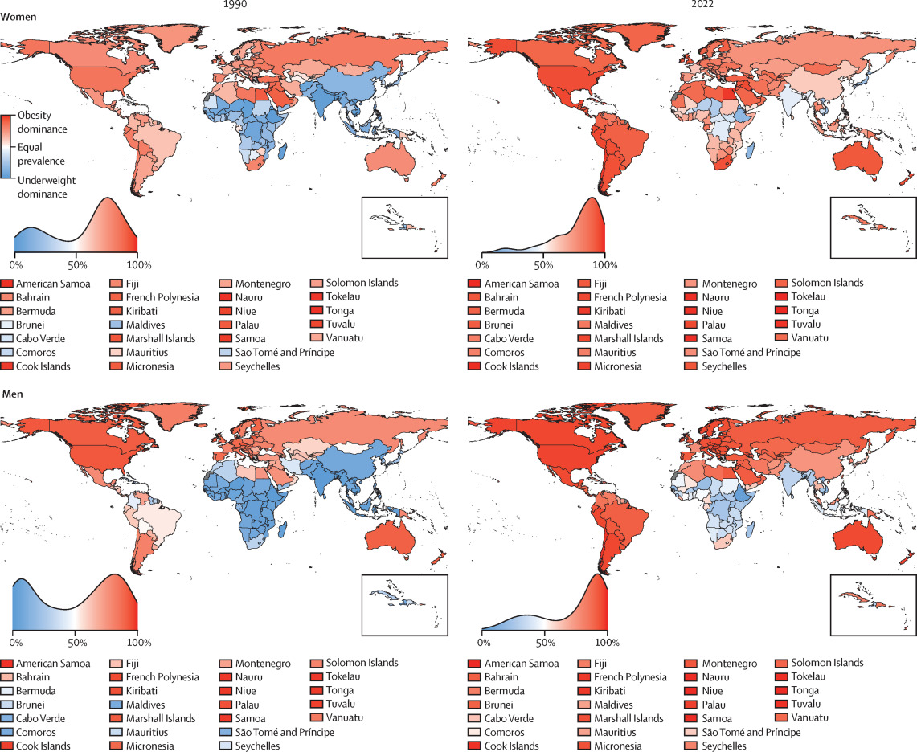
More than 1 billion
people living
with obesity:
880 million adults
159 million children

Slide 4
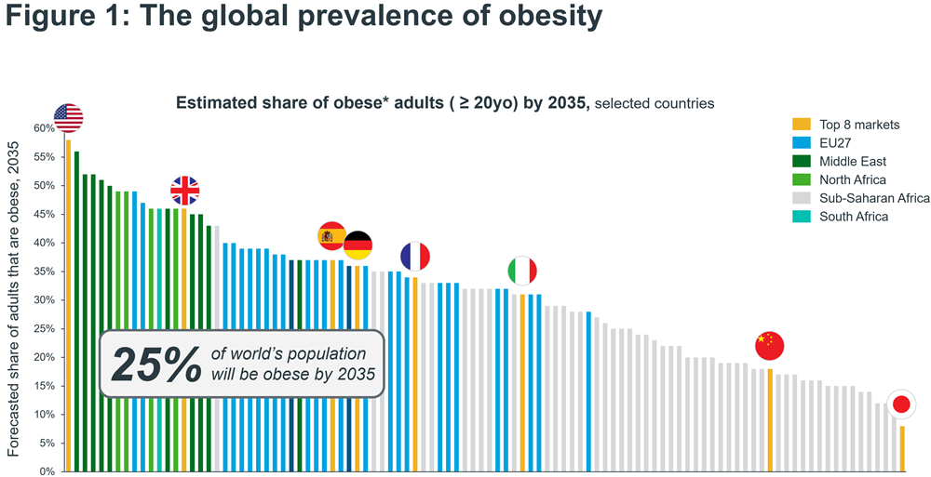

Slide 5


Slide 6
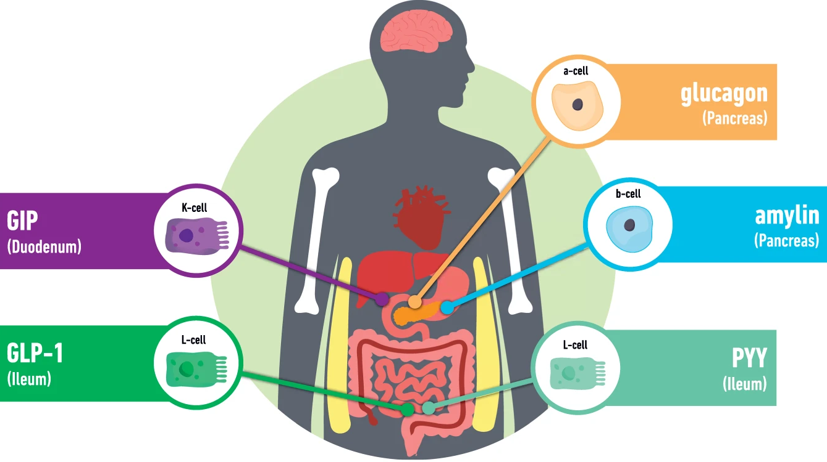

Slide 7
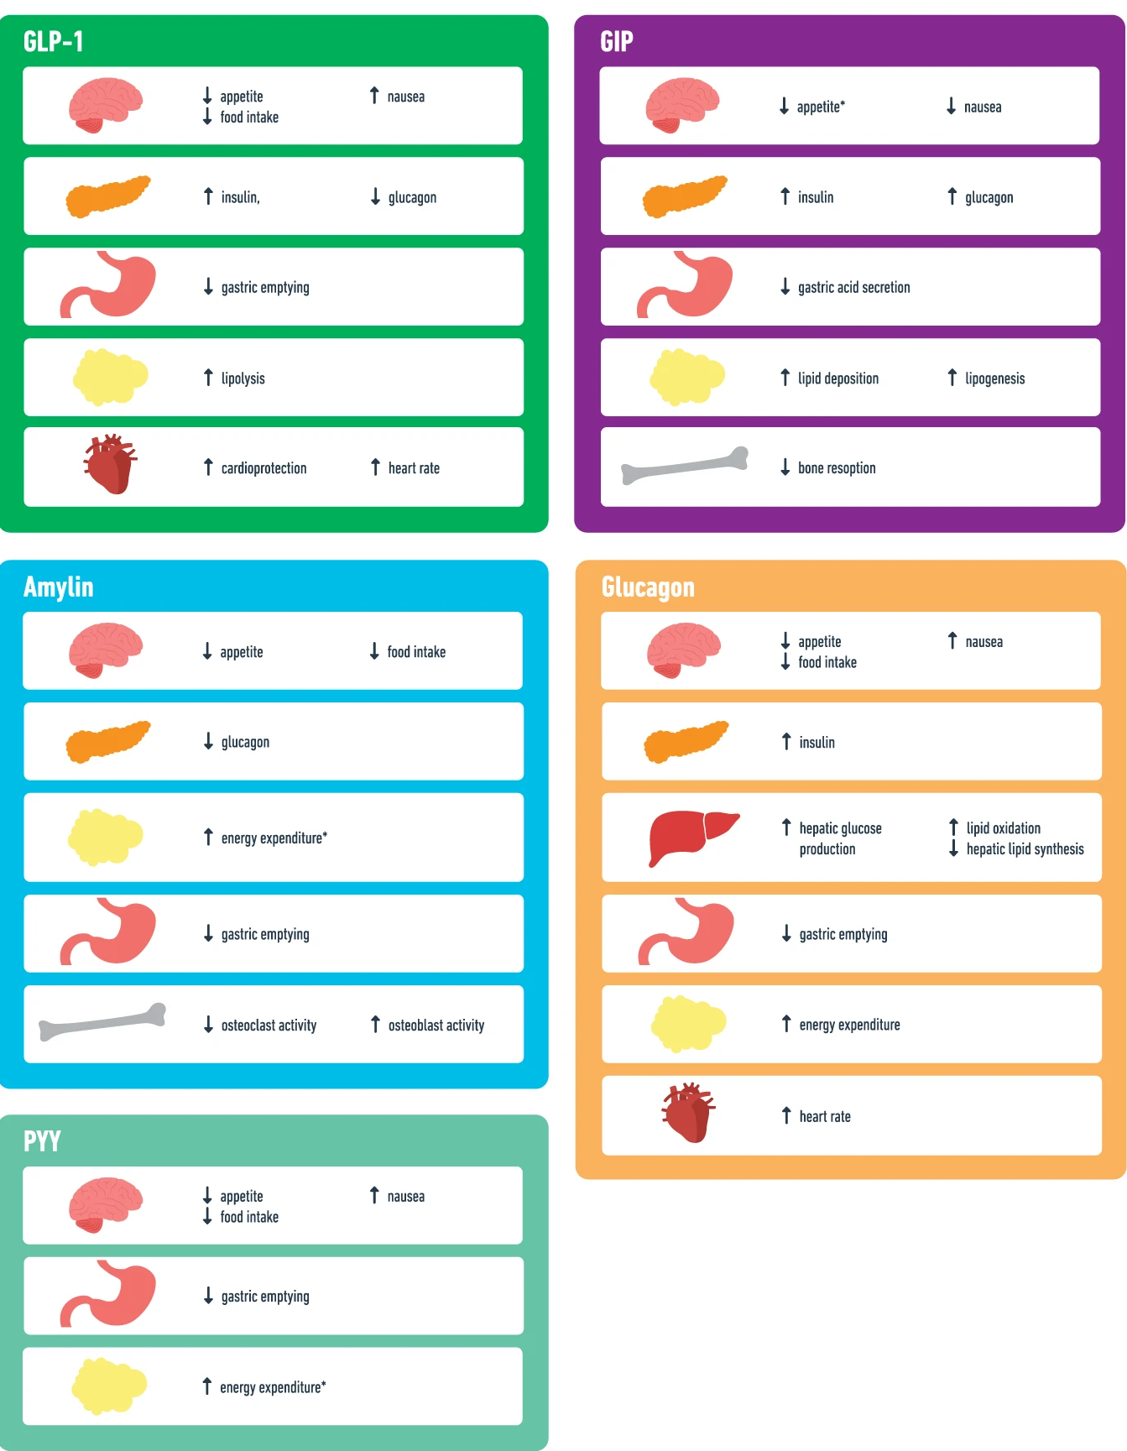

Slide 8
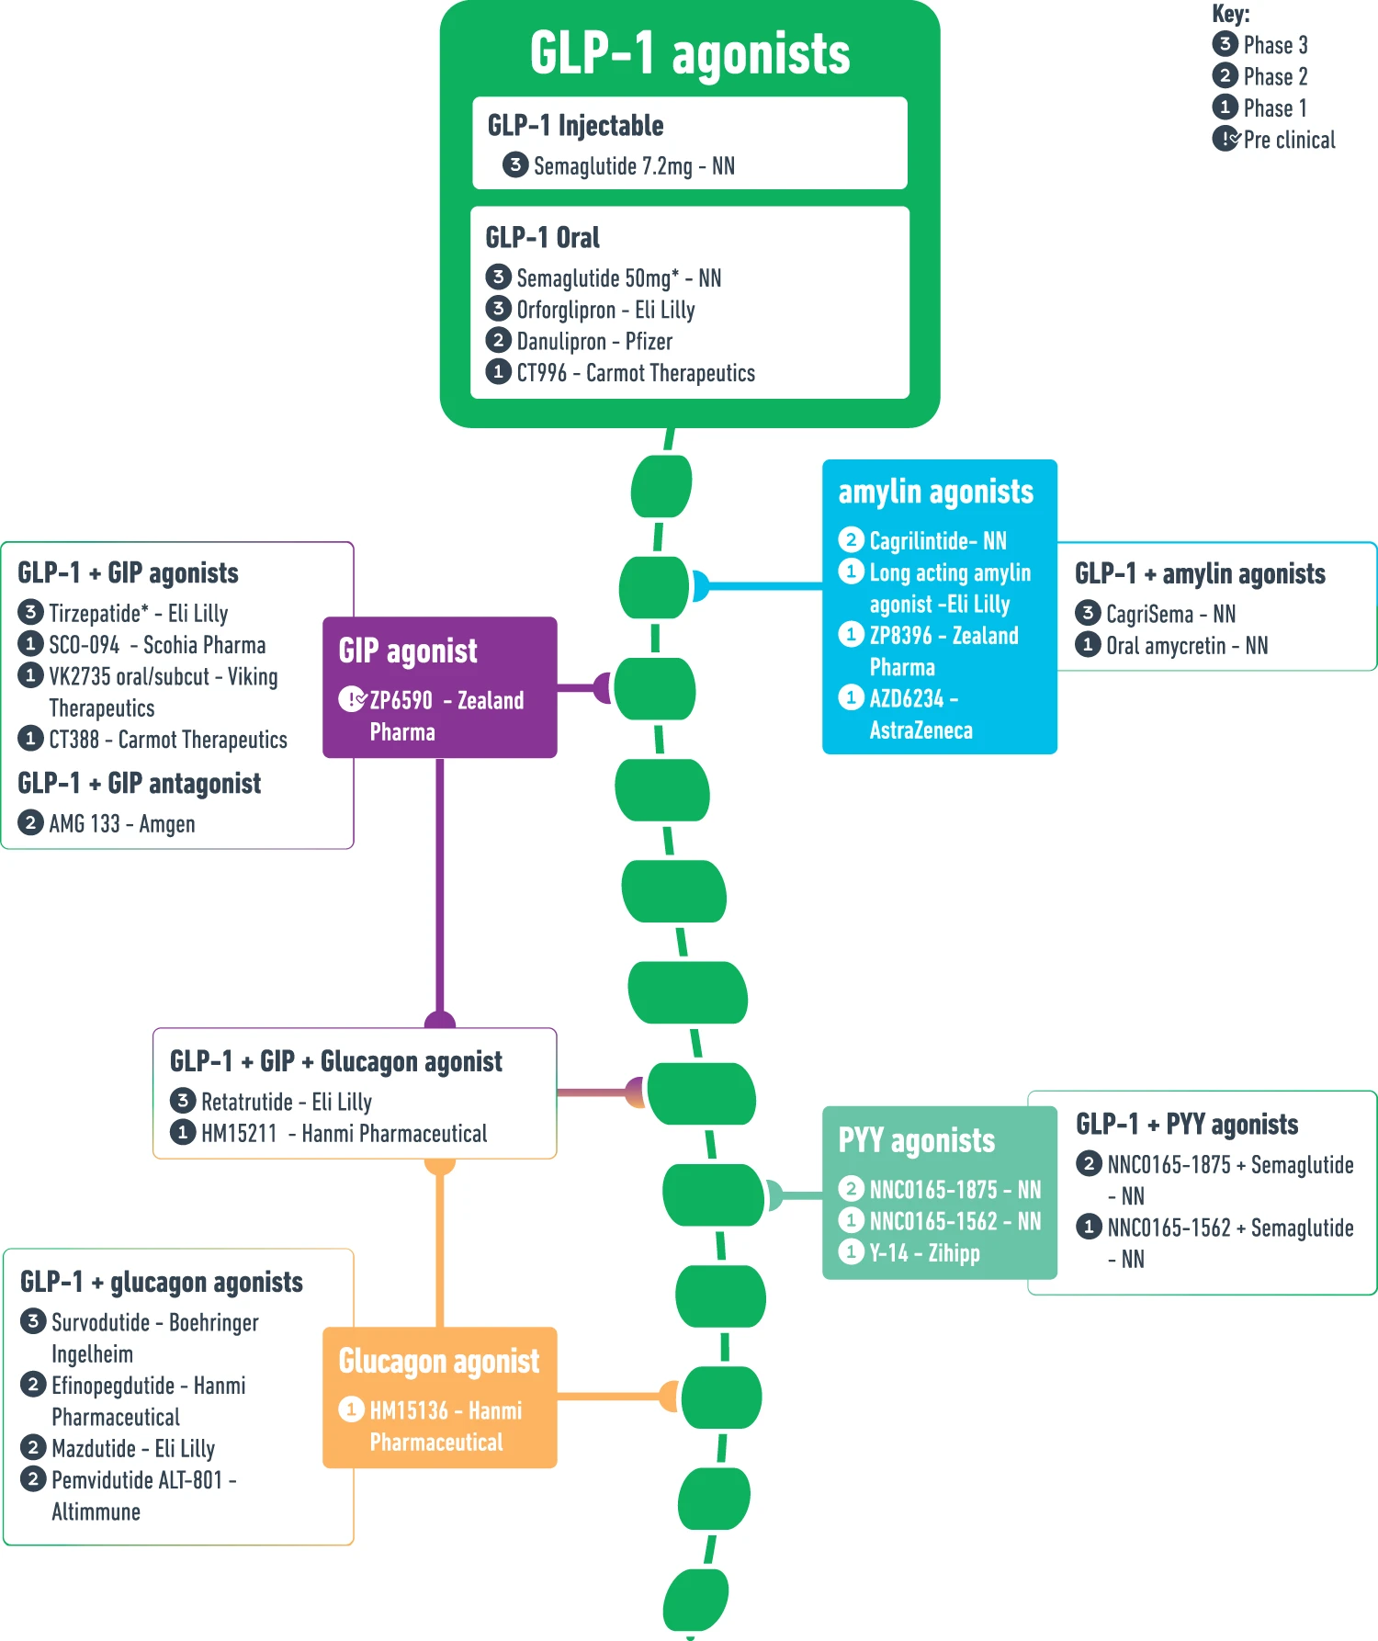

Slide 9
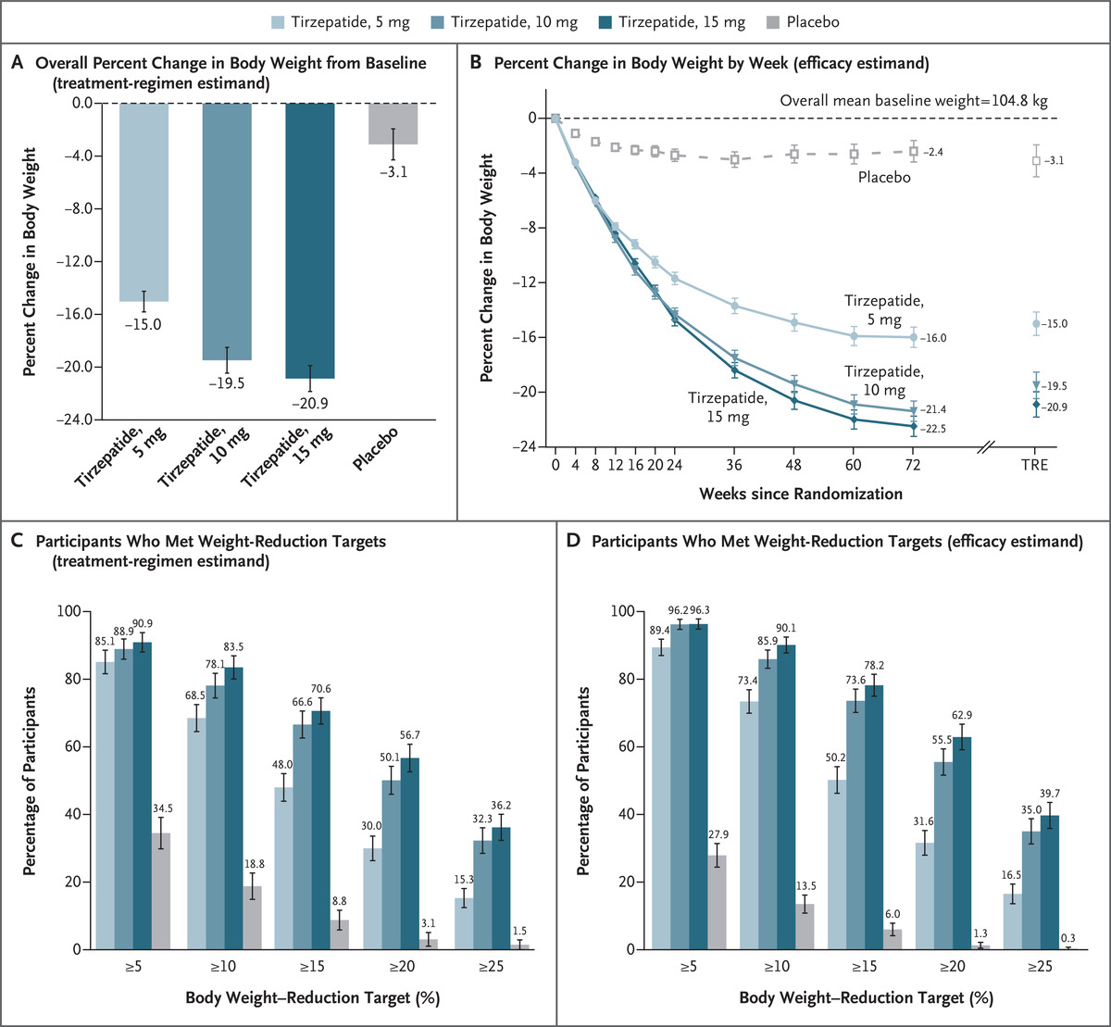
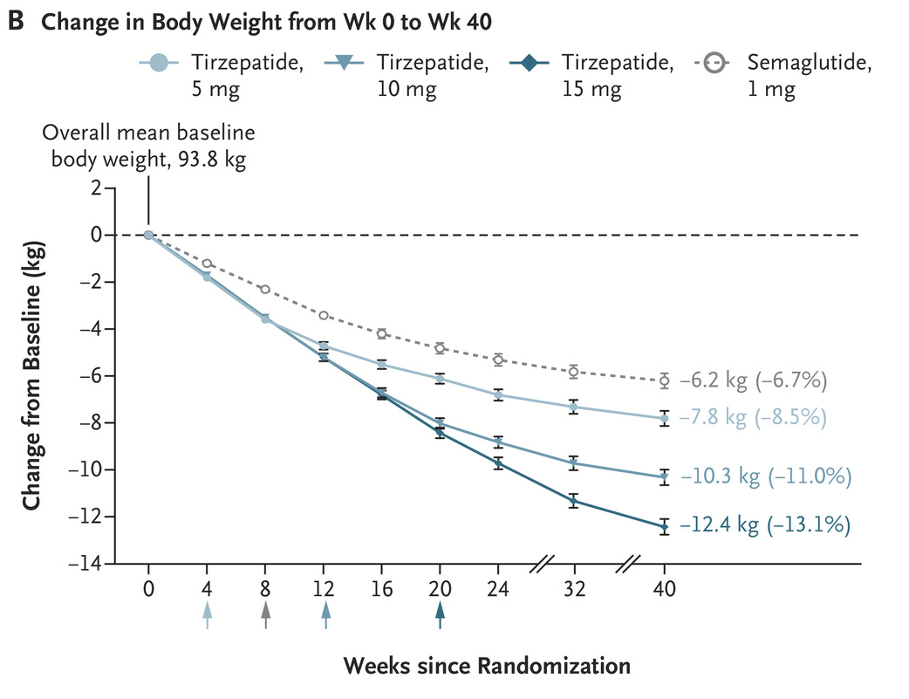
AM Jastreboff et al. 397, P293-304, JANUARY 23, 2021 N Engl J Med 2022.
Frias JP et al N Engl J Med 2021; 385:503-515

Slide 10
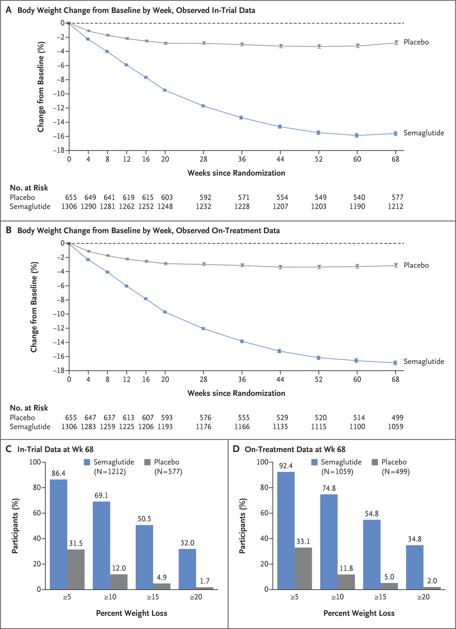
N Engl J Med 2021;384:989-1002

Slide 11
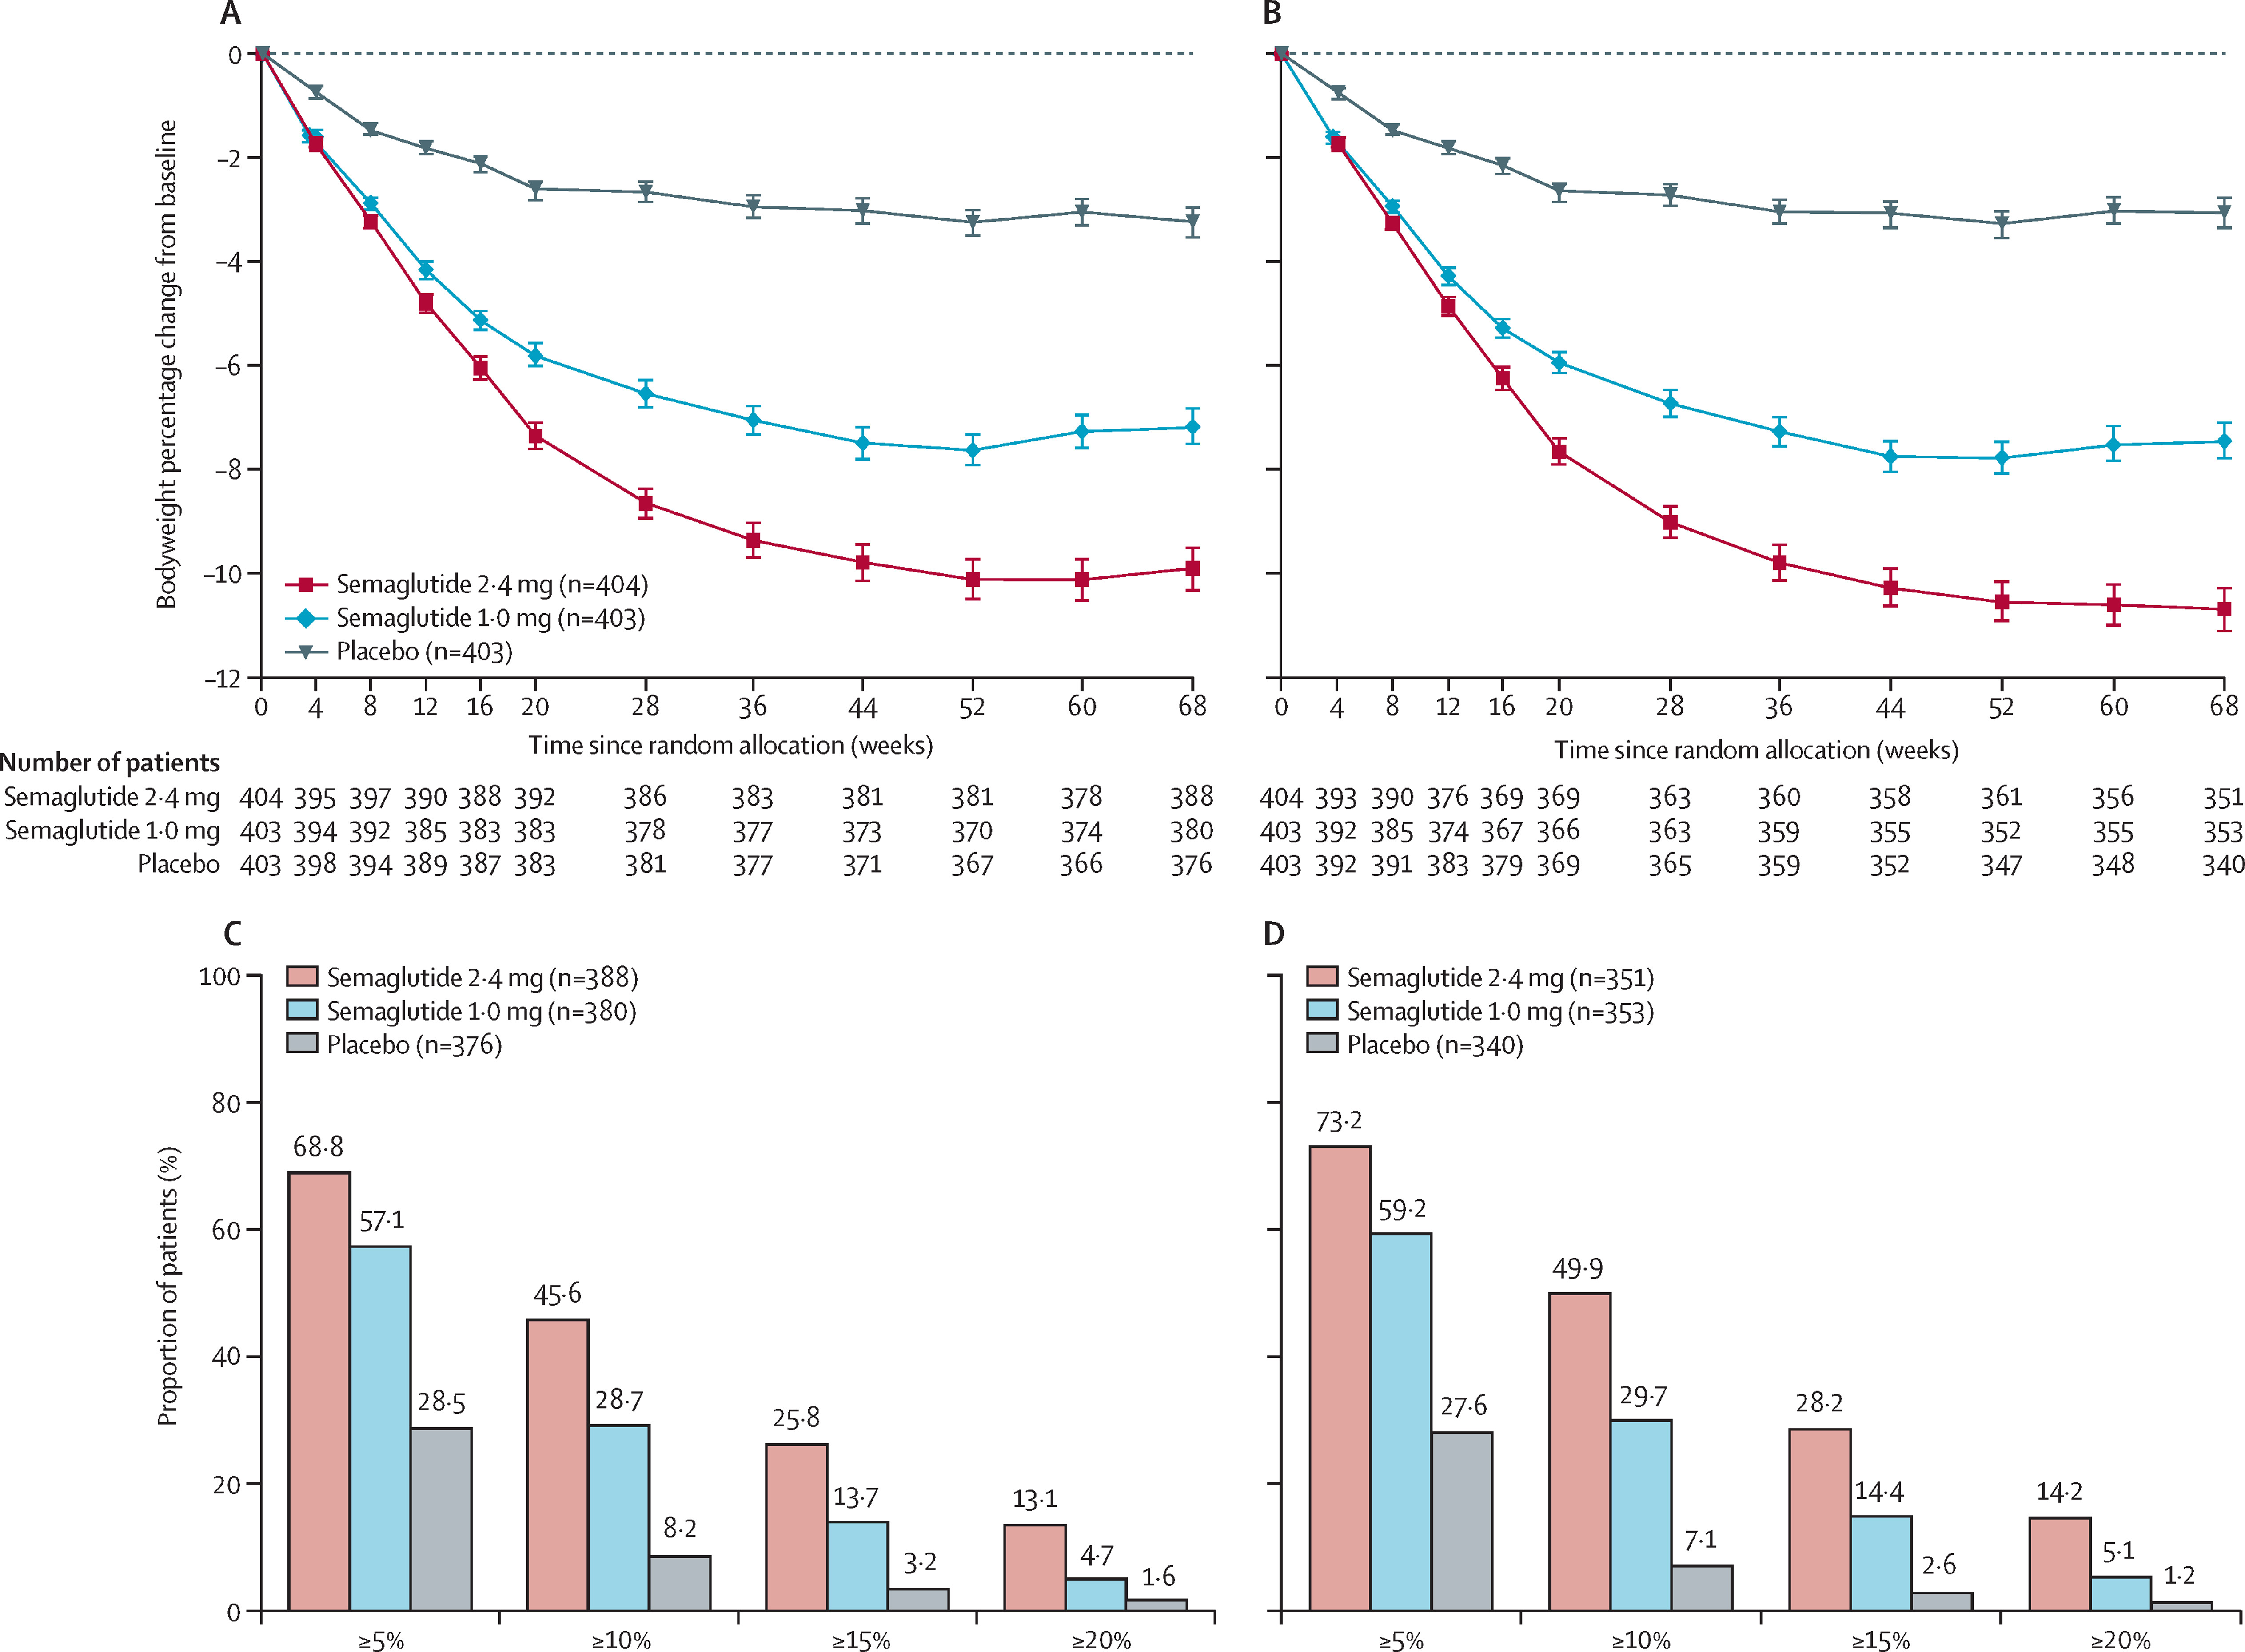
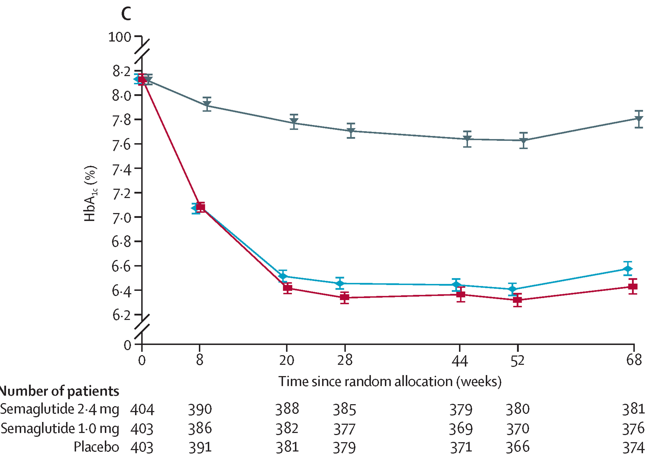
in-trial observation period
on treatment observation period
8%
Semaglutide 2·4 mg once a week
in adults with overweight or obesity,
and type 2 diabetes (STEP 2):
a randomised, double-blind,
double-dummy, placebo-controlled,
phase 3 trial
Lancet. 2021 Mar 13;397(10278):971-984.

Slide 12
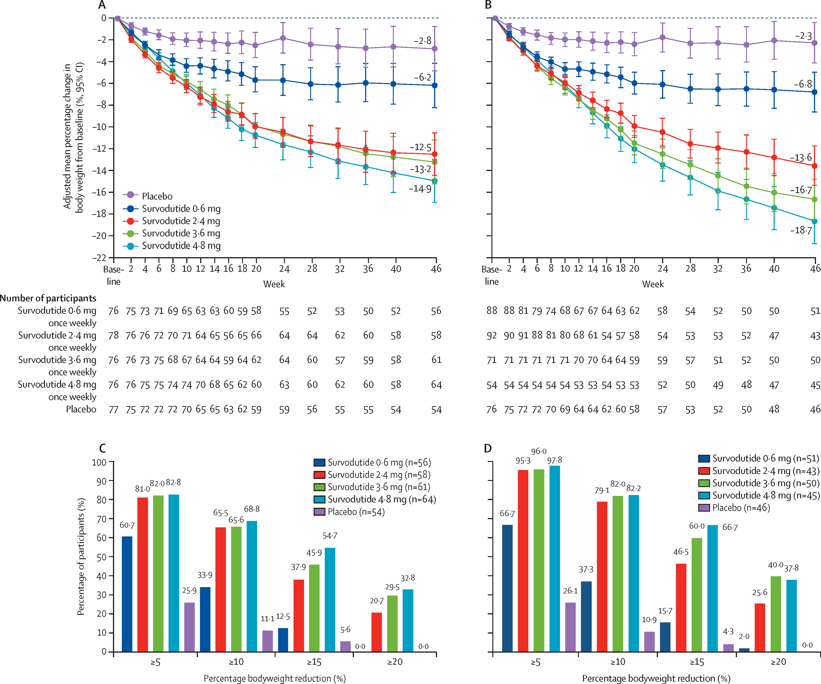
Lancet Diabetes Endocrinol.
2024 Mar;12(3):162-173.

Slide 13
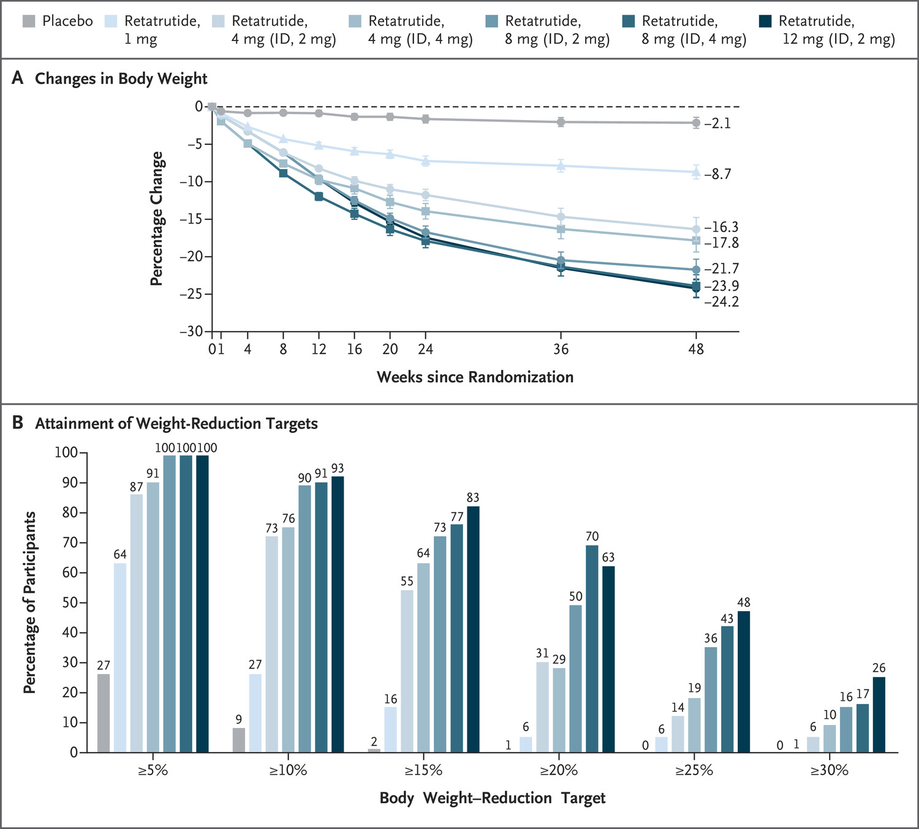
Phase 2 Trial
N Engl J Med 2023;389:514-526

Slide 14
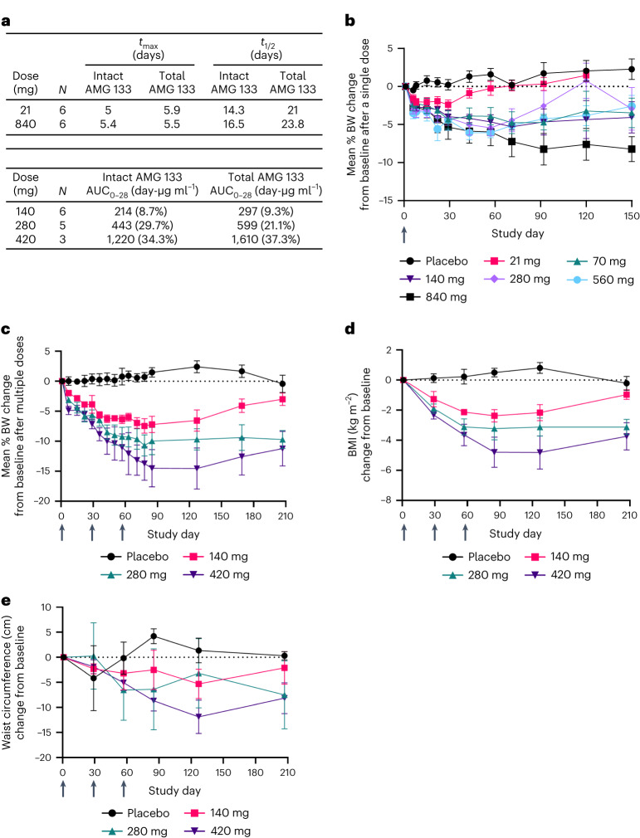
AMG 133 Amgen
(maridebart cafraglutide)
is a dual GIPR antagonist
and GLP-1R agonist
immunoglobulin G1-kappa,
anti-GIPR (gastric inhibitory
polypeptide receptor)
monoclonal antibody
Nat Metab. 2024 Feb 5;6(2):290–303

Slide 15
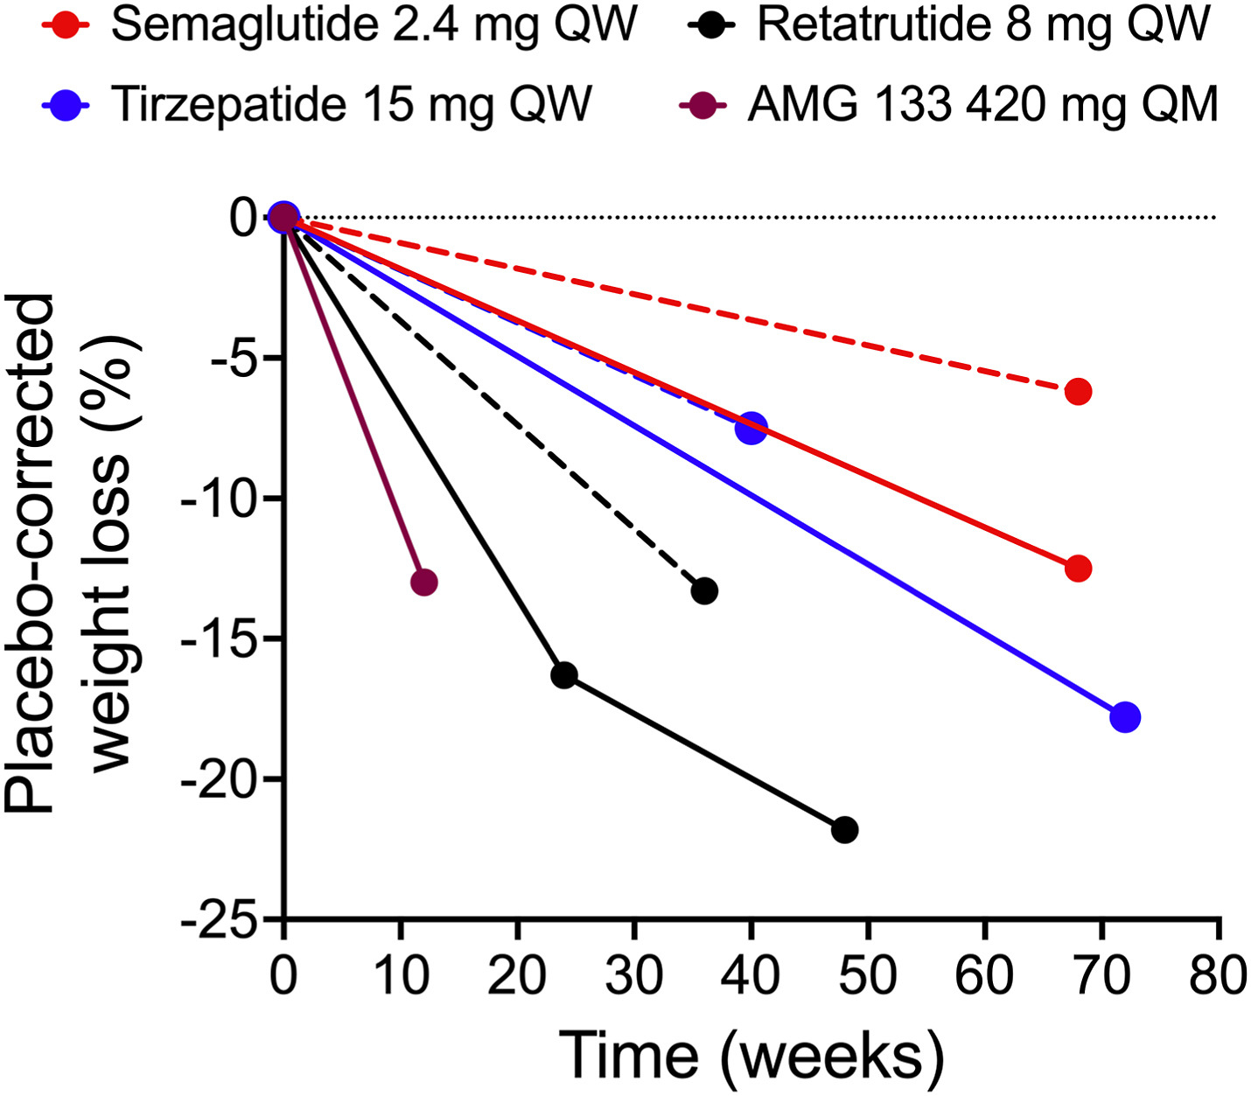

The Lancet Regional Health – Europe 2024 47DOI: (10.1016/j.lanepe.2024.101100)
The Lancet Regional Health – Europe 2024 47DOI: (10.1016/j.lanepe.2024.101100)

Slide 16

There is an unmet need for therapies that reduce
CV events and support weight management
523
million people had CVD in 2019 (globally)¹
49%
of global CV deaths are due to CHD¹
More than
764
million people estimated
to live with obesity
as of 2020³
1,025
million people
predicted to have obesity
by 2030⁴
32%
of all global deaths are from CVD²
Effective interventions that lower CV events & death in this population are greatly needed!⁵
Conditions included in CVD definition may vary. CHD, coronary heart disease; CV, cardiovascular; CVD, cardiovascular disease.
1. Roth GA et al. J Am Coll Cardiol 2020;76:2982–3021; 2. WHO. Fact sheet – CVDs. Available at: https://www.who.int/en/news-room/fact-sheets/detail/cardiovascular-diseases-(cvds). Accessed January 2023; 3. World Obesity Federation. World obesity atlas 2022. Available at: https://www.worldobesity.org/resources/resource-library/world-obesity-atlas-2022. Accessed March 2023; 4. World Obesity Federation. World obesity atlas 2022. Available at: https://www.worldobesity.org/resources/resource-library/world-obesity-atlas-2022. Accessed January 2023; 5. GBD 2015 Obesity Collaborators. N Engl J Med 2017;377:13–27.
Materiale destinato unicamente agli operatori sanitari. Vietata la distribuzione o l'esposizione al pubblico.

Slide 17
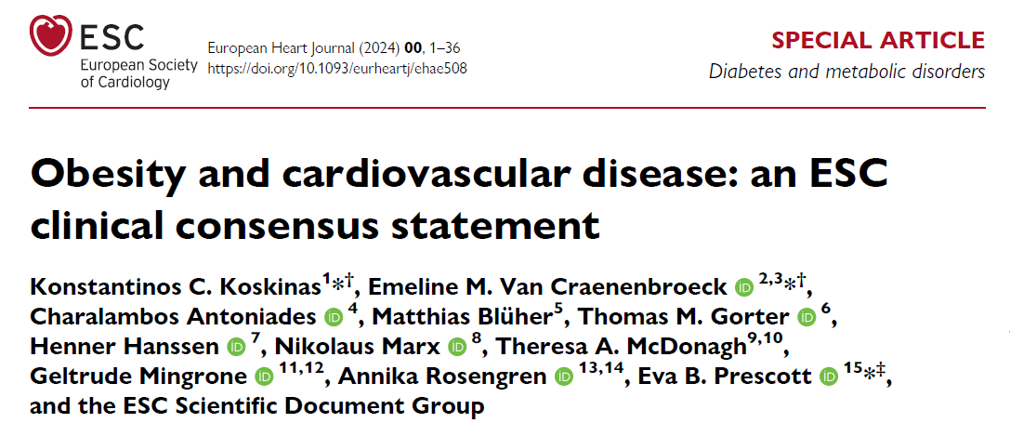

Slide 18
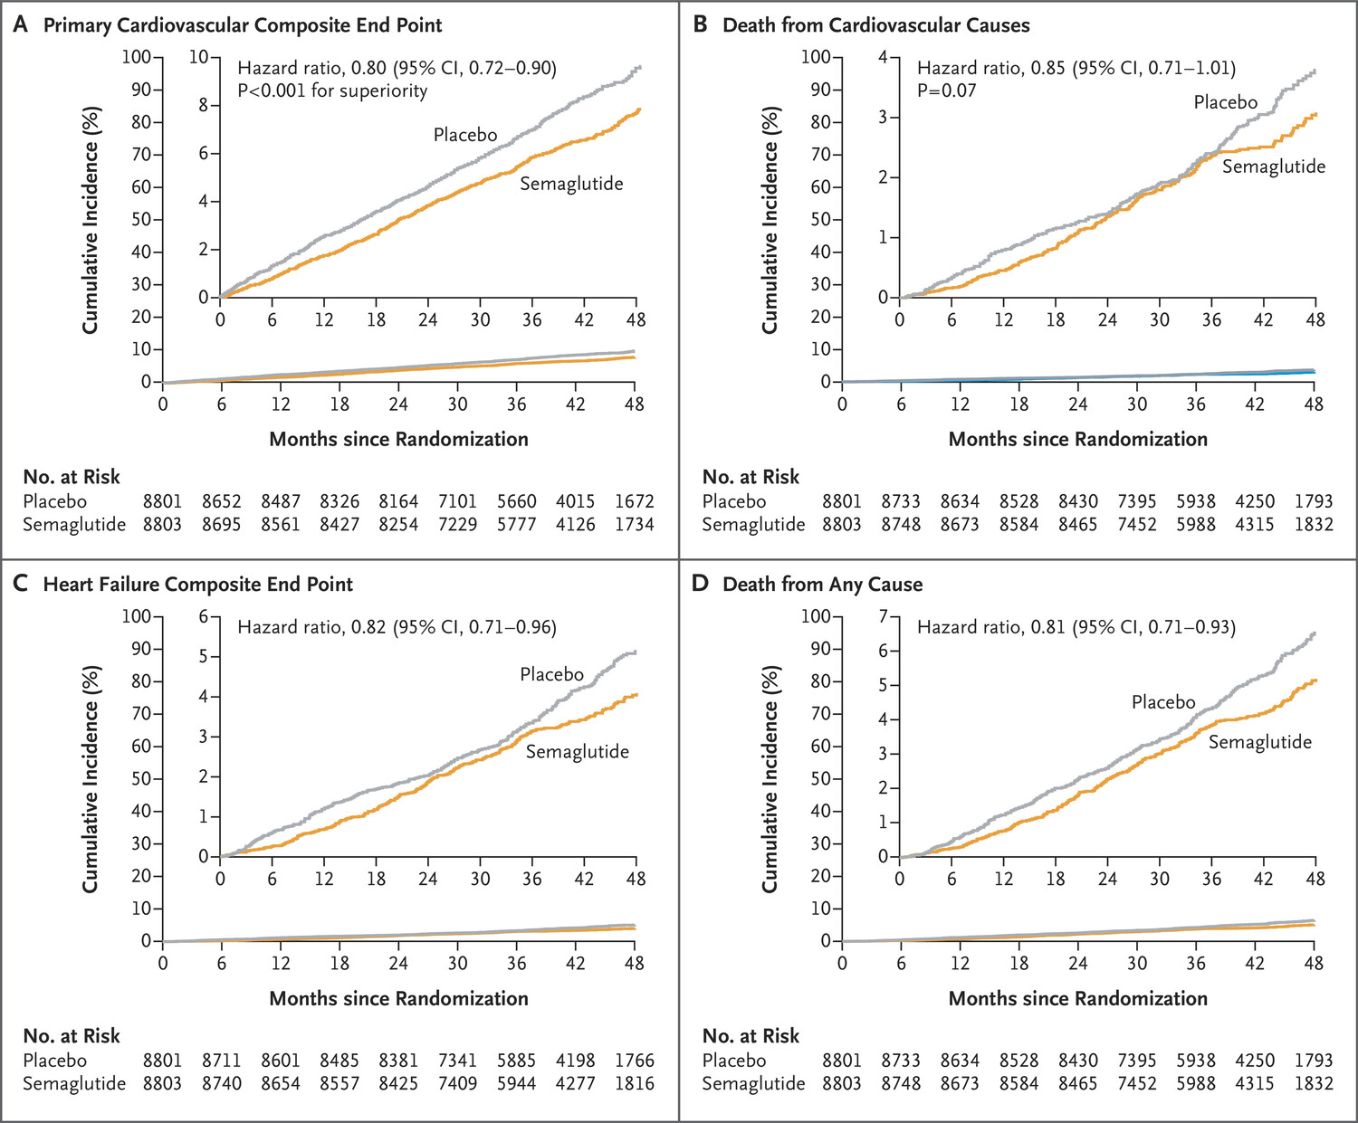
N Engl J Med. 2023
Dec 14;389(24):
2221-2232.

Slide 19
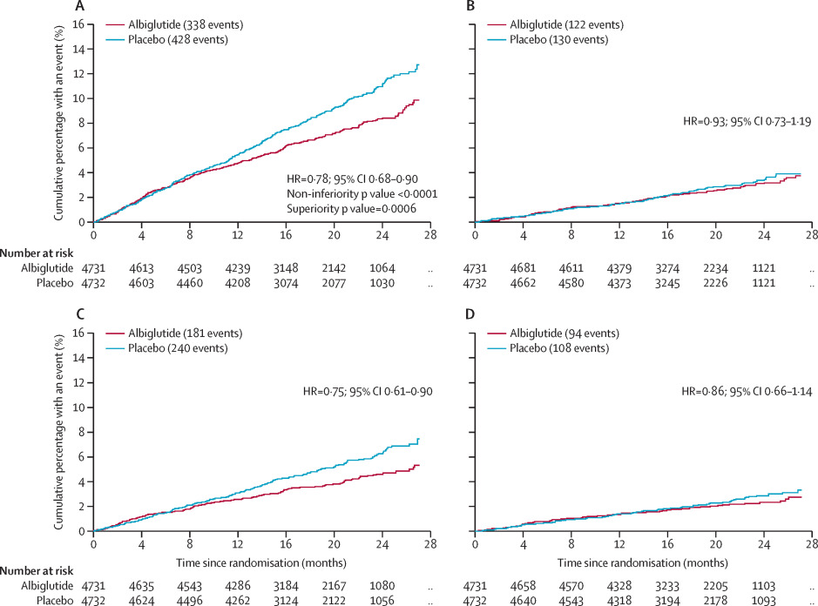
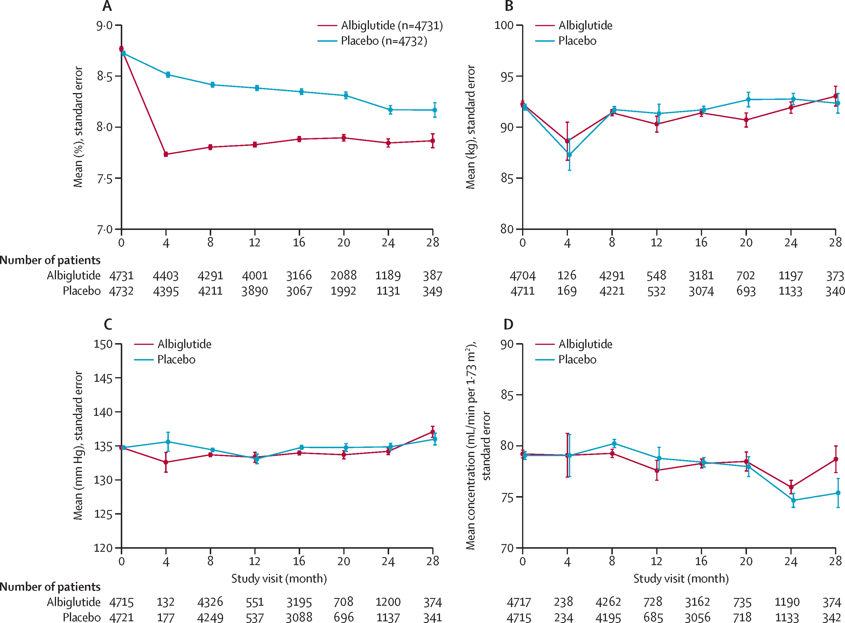
ALBIGLUTIDE
composite of death from cardiovascular causes
cardiovascular death
HbA1
body weight
myocardial infarction
stroke
systolic blood pressure
eGFR
Lancet. 2018 Oct 27;392(10157):1519-1529.

Slide 20
A Meta-Analysis with Meta-Regression. Diabetes Ther. 2020 Oct;11(10):2429-2440.

Slide 21
Of an estimated 687,866 patients at an annual 2435 hospitals, 69.9% underwent SG and 30.1% RYGB, with median costs of $10,900 (interquartile range: 8600-14,000) and $13,600 (10,300-18,000), respectively.
Am Surg. 2023 Oct;89(10):4061-4065.
COST PER YEAR
 | UK | US | Germany | Denmark | Italy
Semaglutide 2.4 mg | $ 3693 | $ 16234 | $ 3918 | $ 4380 | $ 5105
Tirzepatide 15 mg | $ 2875 | $ 12829 | $ 3337 |  | $ 8602

Slide 22
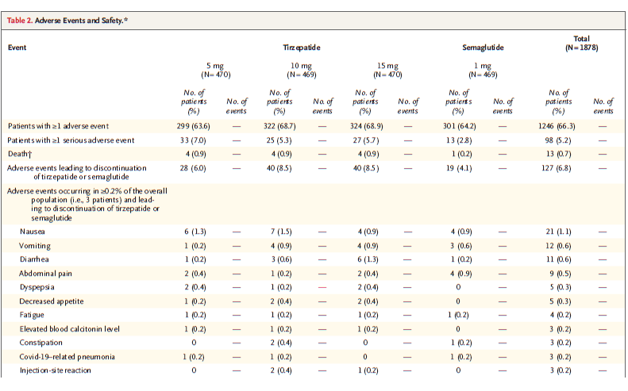
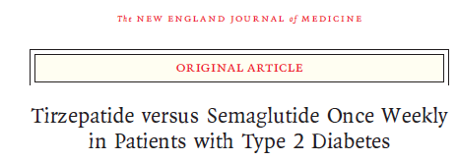
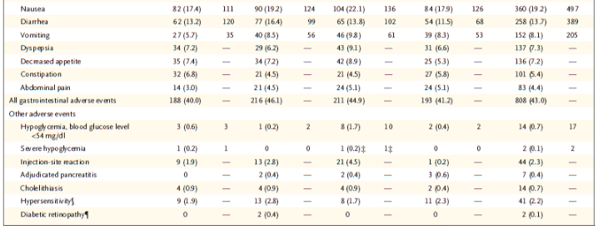

Slide 23
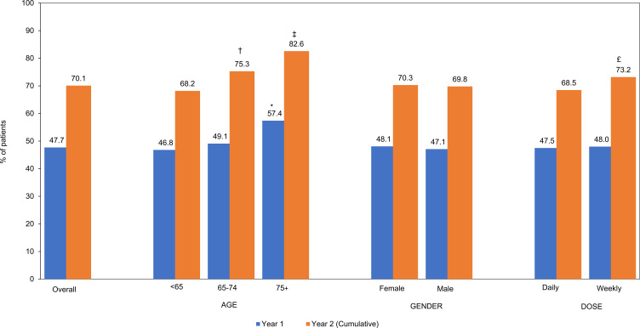
Proportion of Patients Who Discontinued GLP-1 RA Therapy, n=4791.
A total of 4791 T2DM patients had ≥1 and 3907 had ≥2 GLP-1 RA prescription claims. 50.9% and 47.4% of patients were adherent at 12 and 24 months, respectively.

Slide 24
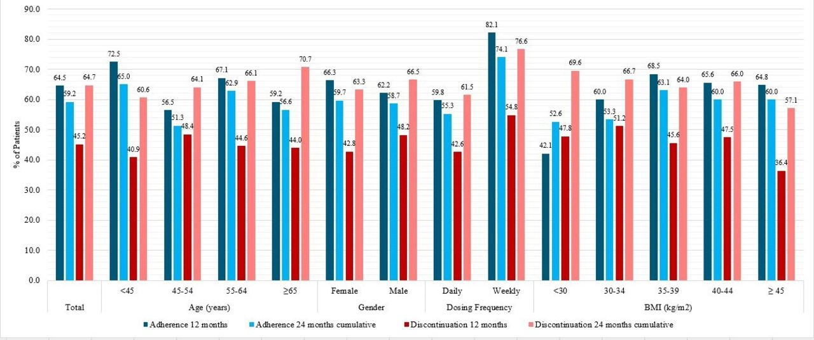
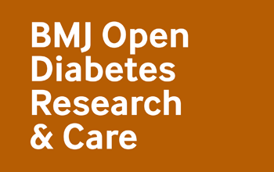
Per cent of patients who were adherent to (n=530)† and discontinued (n=589) GLP-1 RA therapy at 12 and 24 months. †Adherence assessed among patients with two or more GLP-1 RA prescriptions. UNITED STATES
“A minority of patients initiating GLP-1 RAs achieved ≥5% weight loss, suggesting the real-world benefit of these agents on weight loss may be lower than that observed in clinical trials. Patients on GLP-1 RAs may benefit from additional support to improve long-term adherence.”
Tracey Weiss et al. BMJ Open Diab Res Care 2022;10:e002517

Slide 25
CONCLUSIONS
GLP-1 receptor agonists (GLP-1 RAs), along with dual GLP-1 and GIP receptor agonists, and triple agonists
targeting GIP, GLP-1, and glucagon receptors, have been shown to significantly reduce appetite and enhance
feelings of satiety, resulting in high weight loss.
The weight loss effect is generally more pronounced in individuals with obesity alone compared to those
with both obesity and type 2 diabetes. However, despite the difference in weight loss, their impact on
glycemic control in individuals with type 2 diabetes appears to be largely independent of weight reduction.
Even with less pronounced weight loss, these agents still achieve substantial reductions in glycated hemoglobin
(HbA1c), highlighting their potent glucose-lowering effects.
In addition, certain GLP-1 RAs, such as semaglutide (at a dose of 2.4 mg) and albiglutide, demonstrate
benefits that extend beyond weight loss. These molecules appear to exert a direct cardioprotective effect,
acting on the heart and arteries, further supporting their role in reducing cardiovascular risks in patients
with obesity and diabetes. This suggests that the therapeutic advantages of these agents encompass
both metabolic and cardiovascular improvements, making them highly valuable in managing these conditions.

Slide 26
Grazie

